Slide 1
Computer Networks
Switching
S.V.Jansi Rani
Associate Professor / CSE
Notes:
The University of Adelaide, School of Computer Science
Chapter 2 — Instructions: Language of the Computer

Slide 2
Agenda
Switching
  Circuit Switching
  Message Switching
  Packet Switching
    Datagram Approach
    Virtual Circuit Approach
Notes:
The University of Adelaide, School of Computer Science
Chapter 2 — Instructions: Language of the Computer

Slide 3



Slide 4
SWITCHING
The process to forward packets coming in from one port to a port leading towards the destination. When data comes on a port it is called ingress, and when data leaves a port or goes out it is called egress.

Slide 5
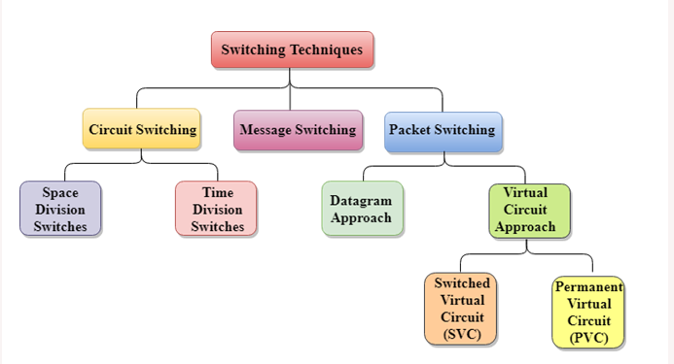

Slide 6
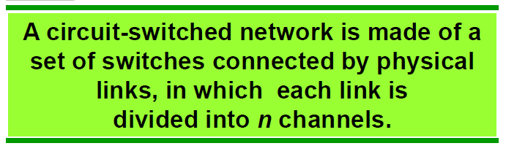
Circuit Switching
Dedicated path between sender and receiver
3 phases -Connection establishment, data transfer, connection disconnection
Each connection uses only one dedicated channel
Link – n Channels – FDM or TDM

Slide 7
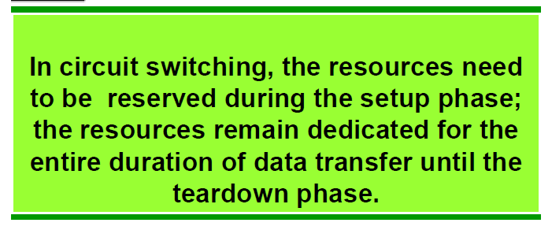
Circuit Switching

Slide 8
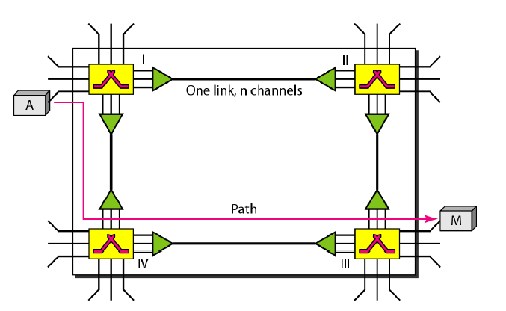
Circuit Switched Network

Slide 9
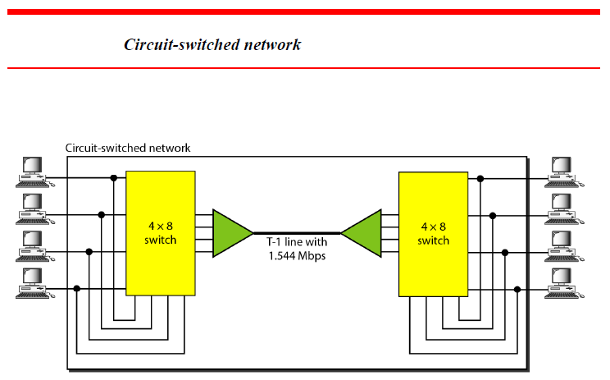
Circuit Switching

Slide 10
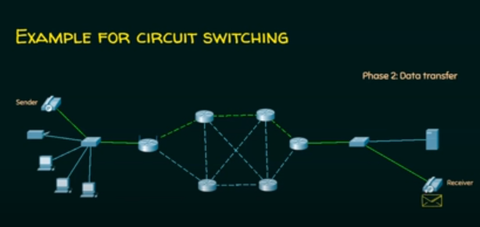

Slide 11
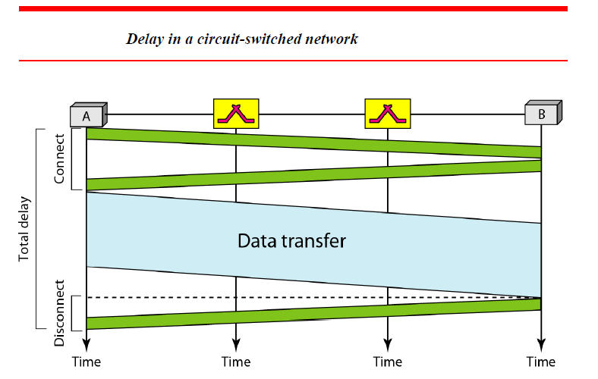

Slide 12
Advantages
The main advantage of circuit switching is that a committed transmission channel is established between the computers which gives a guaranteed data rate.
In circuit switching there is no delay in data flow because of the dedicated transmission path.

Slide 13
Disadvantages
It takes long time to establish connection.
More bandwidth is required in setting up of dedicated channels.
It cannot be used to transmit any other data even if the channel is free as the connection is dedicated in circuit switching.

Slide 14
Message Switching
Store and forward mechanism
Message is transferred as a complete unit
Not suited for streaming media and real time applications

Slide 15
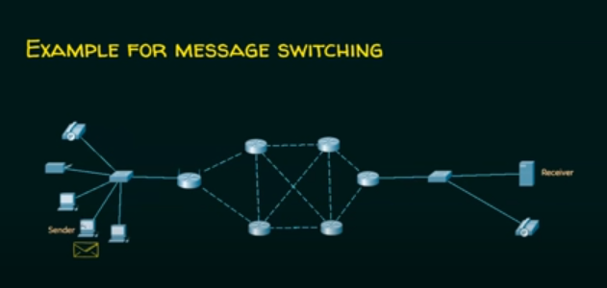

Slide 16
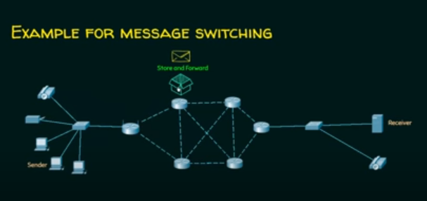

Slide 17
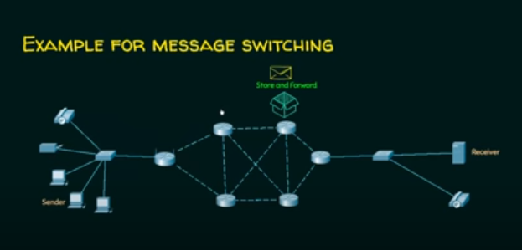

Slide 18
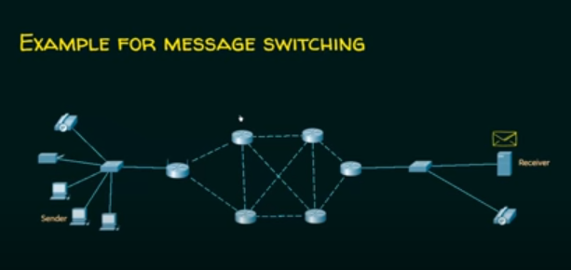

Slide 19
Advantages
As message switching is able to store the message for which communication channel is not available, it helps in reducing the traffic congestion in network.
In message switching, the data channels are shared by the network devices.
It makes the traffic management efficient by assigning priorities to the messages.

Slide 20
Disadvantages
Message switching cannot be used for real time applications as storing of messages causes delay.
In message switching, message has to be stored for which every intermediate devices in the network requires a large storing capacity.

Slide 21
Applications of Message Switching
Telegraph
Mail forwarding

Slide 22
Packet Switching
Internet is a packet switched network
Message is broken into individual chunks called packets
Each packet is sent individually
It has source and destination IP with sequence number
Sequence number will help the receiver to
  Reorder packet
  Find missing packet
  Send acknowledgements

Slide 23
Packet Switching
Two Approach
Datagram Approach
Virtual circuit approach

Slide 24
Datagram Approach
It is known as connectionless switching
Each independent entity is called as datagram
Datagram contains destination information and using this information , the intermediate devices will forward it to right destination
Path is not fixed
Intermediate nodes takes decision to forward the datagram

Slide 25
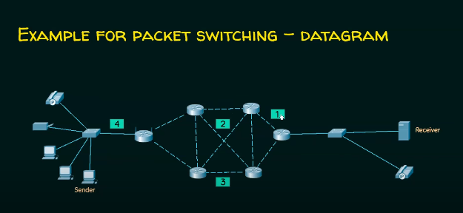

Slide 26
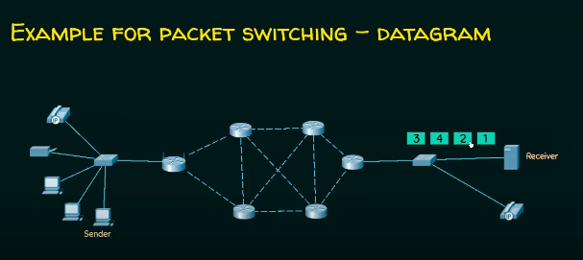

Slide 27
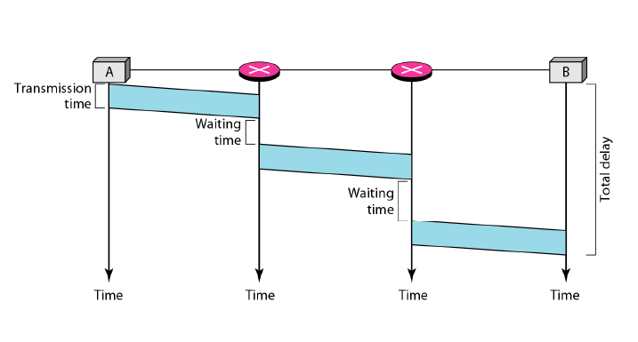
Delay in Datagram Network

Slide 28
Packet Switching – Virtual Circuit Approach
It is also known as connection oriented switching
Pre planned route is fixed before message is sent
Call request and call accept sent for connection establishment
Path is fixed during logical connection

Slide 29
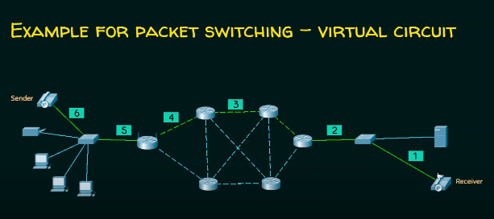

Slide 30
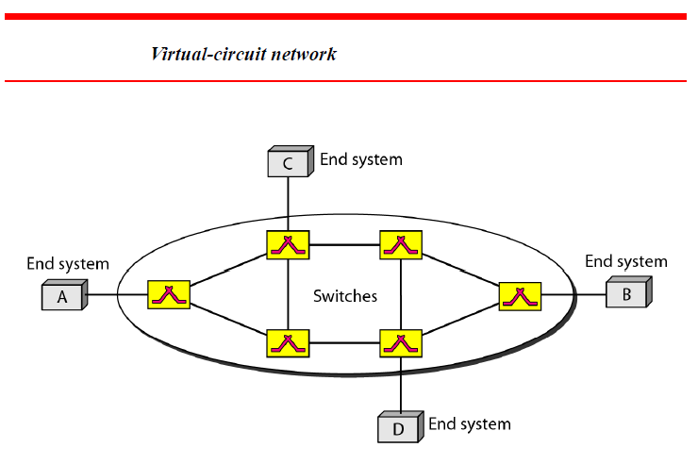

Slide 31
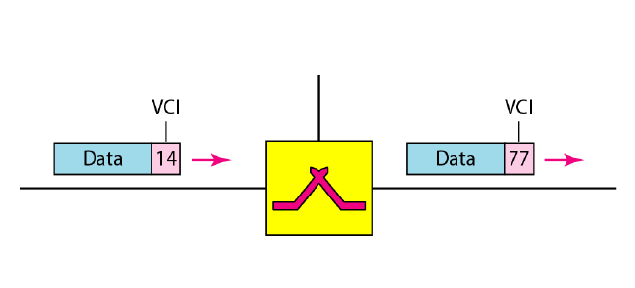
Virtual Circuit Identifier

Slide 32
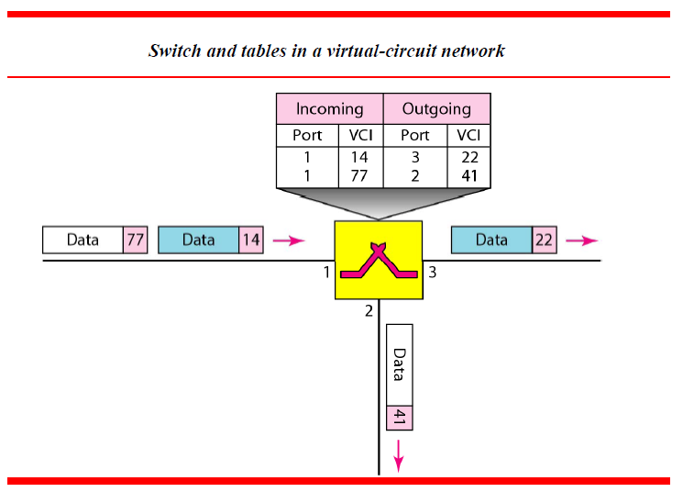

Slide 33
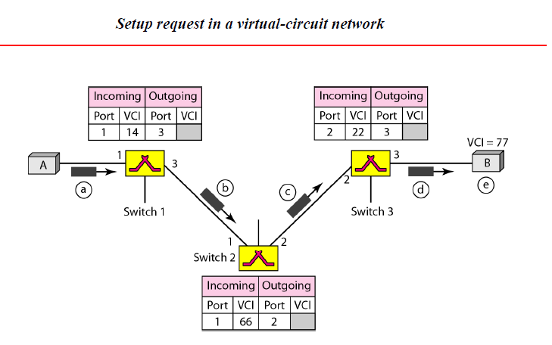

Slide 34
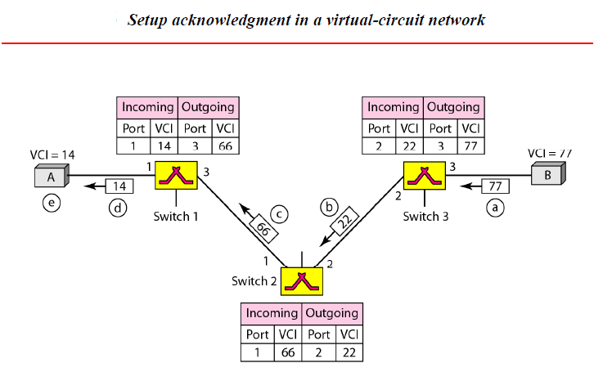

Slide 35
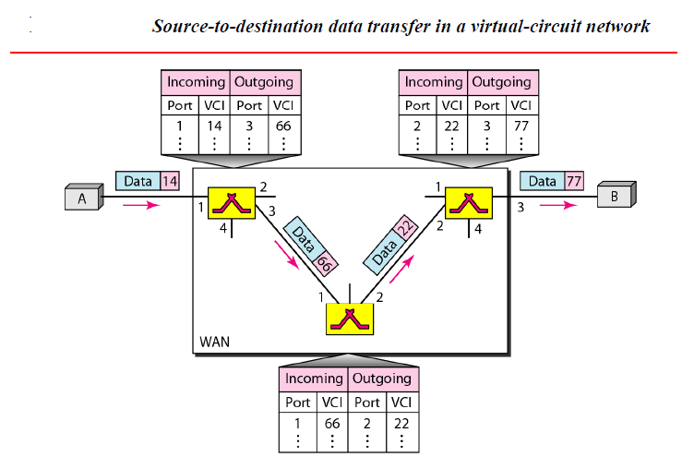

Slide 36
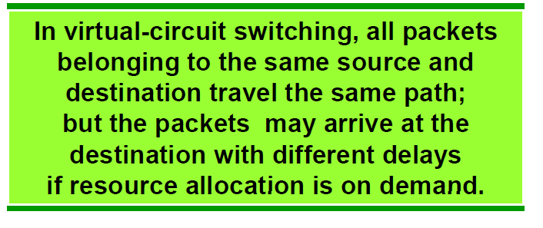

Slide 37
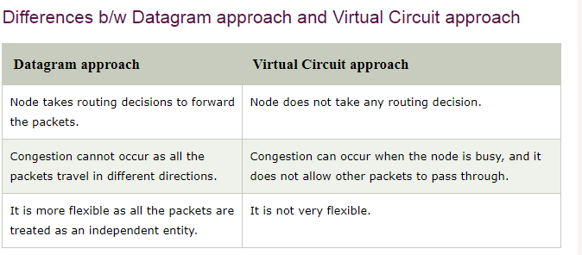

Slide 38
Advantages
Delay in delivery of packets is less, since packets are sent as soon as they are available.
Switching devices don’t require massive storage, since they don’t have to store the entire messages before forwarding them to the next node.
Data delivery can continue even if some parts of the network faces link failure. Packets can be routed via other paths.
It allows simultaneous usage of the same channel by multiple users.
It ensures better bandwidth usage as a number of packets from multiple sources can be transferred via the same link.

Slide 39
Disadvantages
Complexity is more at each node because of the facility to follow multiple path.
Transmission delay is more because of rerouting.
They are unsuitable for applications that cannot afford delays in communication like high quality voice calls.
They require complex protocols for delivery.
Network problems may introduce errors in packets, delay in delivery of packets or loss of packets. If not properly handled, this may lead to loss of critical information.

Slide 40
Check Your Understanding
Telegraph is an example for ___________________
___________ takes routing decision to forward packets in datagram approach
The connection oriented switching with dedicated path is called _________________
Store and forward mechanism is used in _____________

Slide 41
THANK YOU

